Slide 1
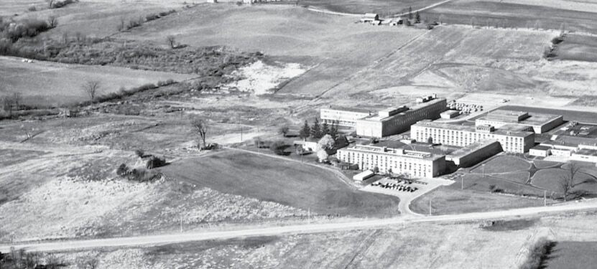
Donna Strickland Department of Physics and Astronomy
Siegman International School on Lasers 2017
August 9, 2017

Slide 2
Higher Order Dispersion
Stretching
Compressing
Can we get back to a transform limited pulse?

Slide 3
Higher Order Dispersion
So far we have looked at all the Taylor expansions only to second order – but to get back to the Transform limit, all orders of phase must be corrected.
Material Dispersion:
φ_{tot}(ω,z) = φ_{tot}(ω,z₀) + β(ω)z

Slide 4
Higher Order Dispersion
If you use a grating dispersion line to compensate for the material GVD, ie. the second order term, then the third order terms will not cancel.
The ratio of the third order to second order dispersion is different for each type of dispersion

Slide 5
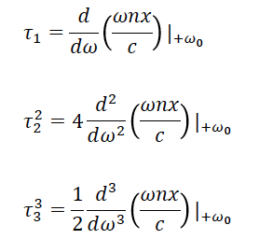
Higher Order Dispersion
Material Dispersion:
The higher order terms are important for large bandwidths
“Analysis of compression of frequency chirped optical pulses by a strongly dispersive grating pair” J.D. McMullen, Appl. Opt. 18, 737-741 (1979)

Slide 6
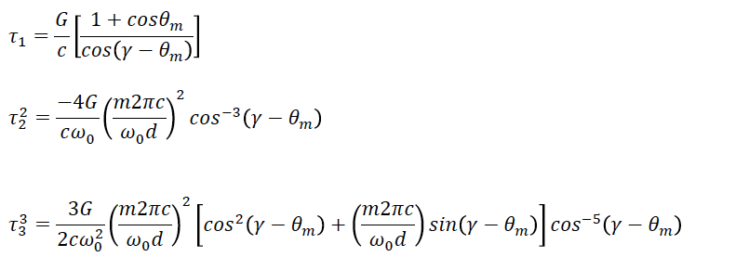
Higher Order Dispersion
Grating Dispersion:
From the Grating Equation:
“Analysis of compression of frequency chirped optical pulses by a strongly dispersive grating pair” J.D. McMullen, Appl. Opt. 18, 737-741 (1979)

Slide 7
Higher Order Dispersion
Since both terms are linear in G, the larger the GDD, the larger the 3rd order term.
You have two terms to play with, the separation G and the angle, γ. You can use a different value of γ, to minimize the third order for a given GDD.
However, the angle will be chosen to be close to Littrow to both maximize the GDD, but also the grating will have the highest grating efficiency at Littrow.

Slide 8
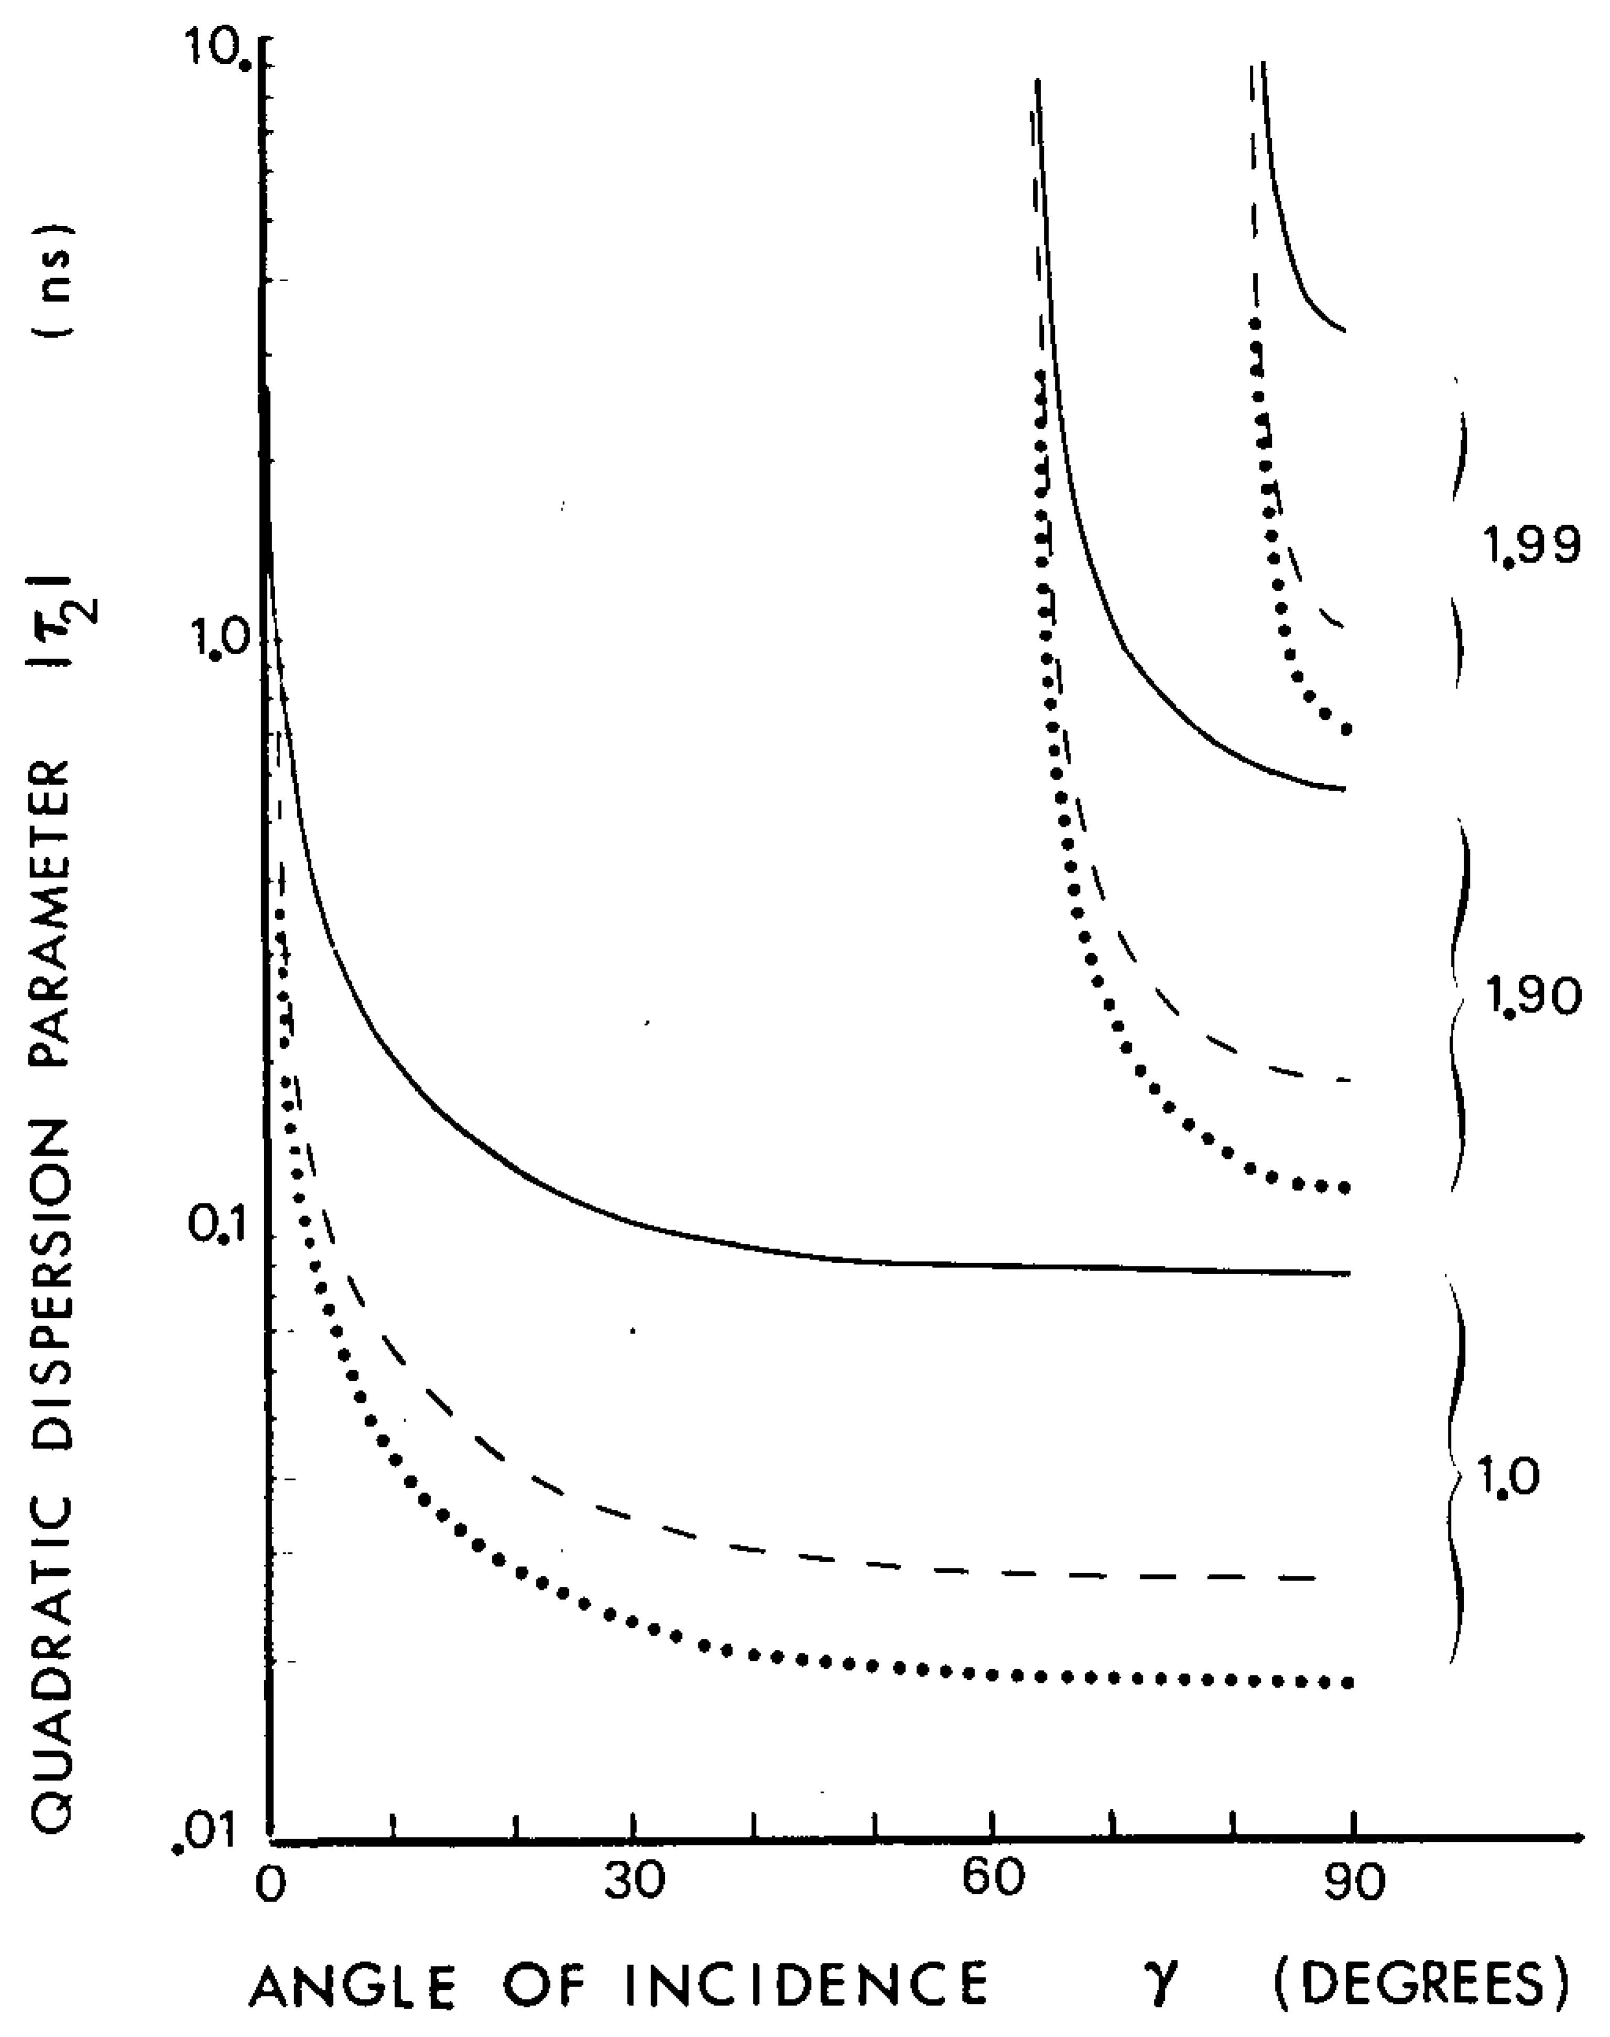
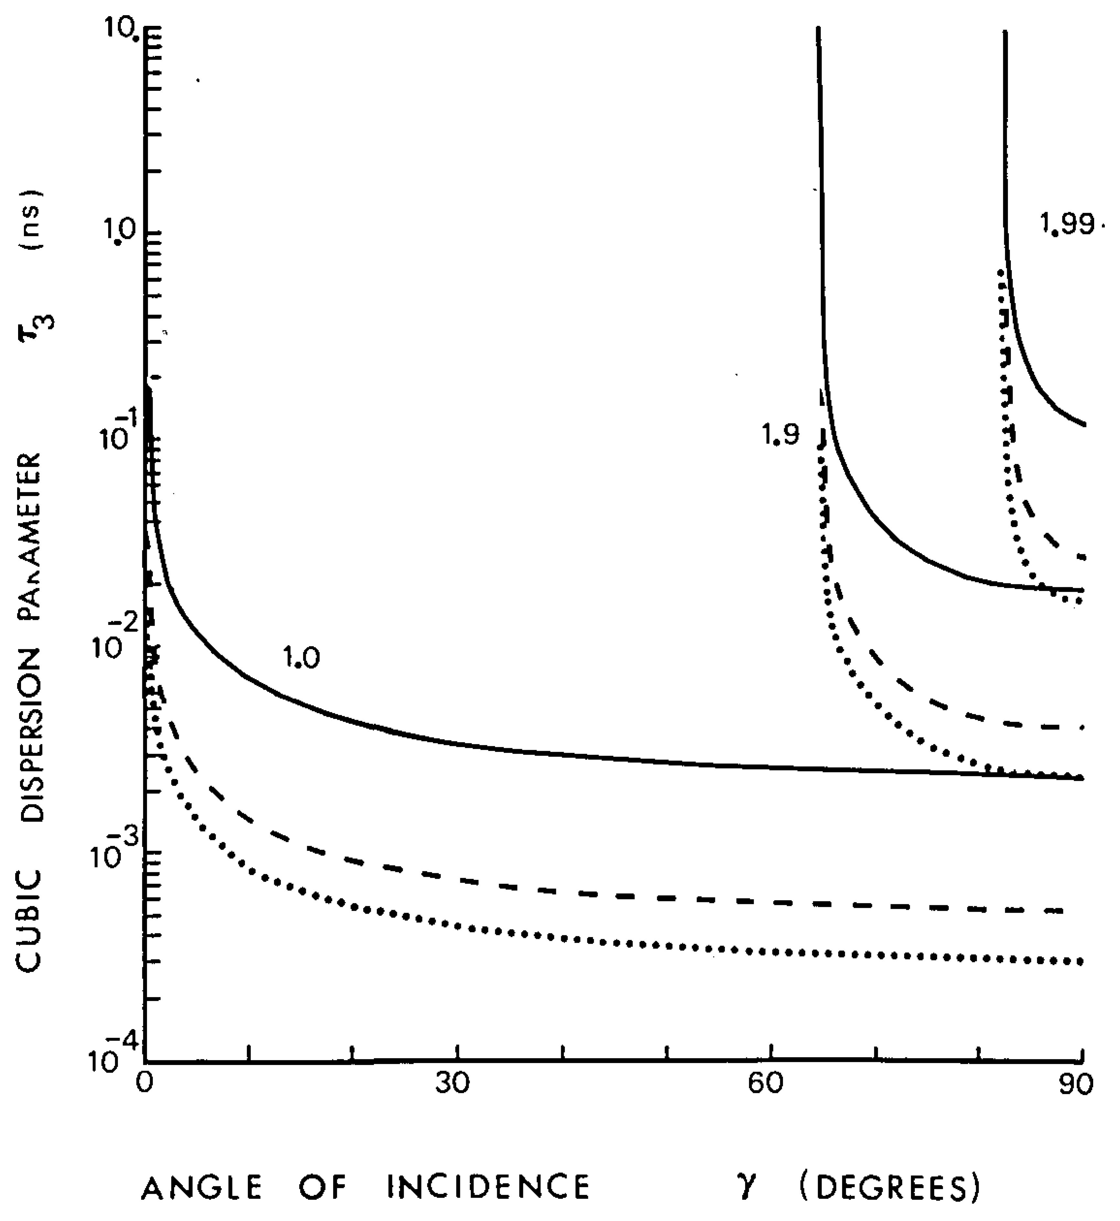
Higher Order Dispersion
To maximize GDD, you would want (γ−θ)to be close to 90° , but the 3rd order dispersion grows as: 1/ cos⁻⁵(γ−θ)
J. D. McMullen, "Analysis of compression of frequency chirped optical pulses by a strongly dispersive grating pair," Appl. Opt. 18, 737-741 (1979); https://www.osapublishing.org/ao/abstract.cfm?uri=ao-18-5-737

Slide 9
Higher Order Dispersion
Ignoring the geometry of the dispersion line, the ratio of the 3rd order phase to the second order phase depends on the bandwidth – started to become important as mode-locked pulses got shorter
So the third order is only significant in the chirped pulse if the bandwidth is a significant fraction of the central frequency.
With today’s two cycle pulses, you correct up to 5th order dispersion.

Slide 10
Higher Order Dispersion
The third order matters most when the dispersion line is set to remove the GDD of the system.
If total system GDD = 0 then the 3rd order gives the largest contribution to the phase difference from the Fourier transform limit.
Ideally you would want to have your compressor have equal but opposite dispersion at all orders.

Slide 11
Higher Order Dispersion
The grating line has opposite sign of second order dispersion from the material dispersion, for wavelengths shorter than 1.5µm
So you can set the separation of the gratings to have equal but opposite GDD and eliminate the linear frequency chirp from the total system – second order in phase

Slide 12
Higher Order Dispersion
The 3rd order terms for material and grating line dispersions are:
Unfortunately, the third order terms typically have the same sign and so can’t be corrected.
There are no more parameters to choose since all the same parameters are in the second and third order term. You can minimize the third order by choosing the best γ.

Slide 13
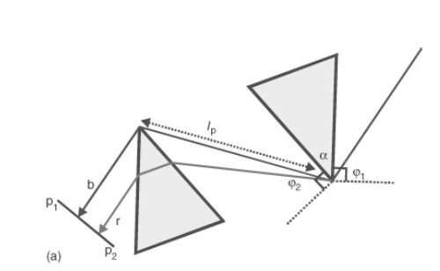
Higher Order Dispersion
Prisms:
The prism line has negative third order dispersion so there is a chance to cancel both 2nd and 3rd order dispersions
Move the prism in or out
Can compensate by changing the amount of material the beam passes in the prism – so there is another parameter at play unlike the gratings

Slide 14
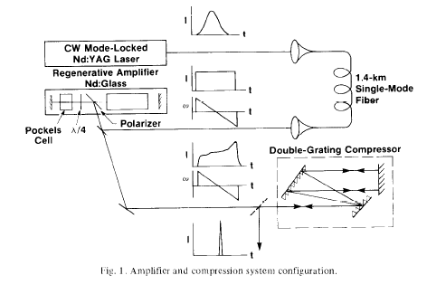
Original Chirped Pulse Amplification System
“Compression of Amplified Chirped Optical Pulses”, D Strickland and G. Mourou, Opt. Commun. 56, 219-221, 1985

Slide 15
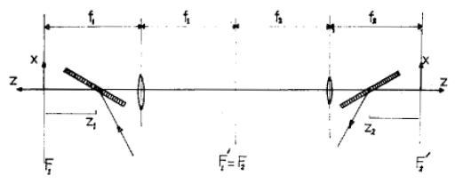
Positive Grating Dispersion Line
“3000 Times Grating Compressor with Positive Group Velocity Dispersion: Application to Fiber Compensation in 1.3-1.6 µm Region”, O.E. Martinez , IEEE J. Quantum Electron, QE-23, p.59, 1987

Slide 16
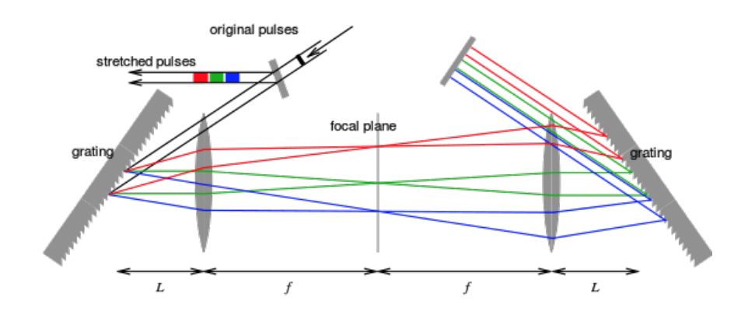
Positive Grating Dispersion Line
Roof Prism
For L<f you get positive dispersion
The dispersion is the same magnitude but opposite sign as for parallel gratings for 2(f-L) = b FOR ALL ORDERS OF DISPERSION

Slide 17
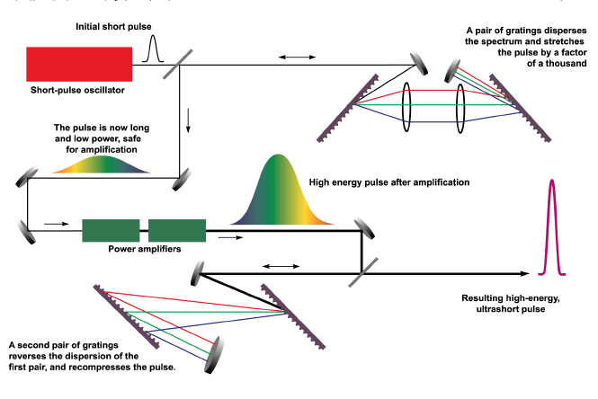
Chirped Pulse Amplification System
The grating compressor can perfectly compensate the grating stretcher to all orders.
However, that doesn’t mean you get a Transform limited pulse out.

Slide 18
Chirped Pulse Amplification System
CPA wants to have large stretching/ compression values and so the higher orders also have relatively large values
Need a well collimated beam, grating separation must be less than the confocal parameter of the beam
The compressor has to also compensate for the dispersion in the amplifiers, which becomes large for ultrashort pulses.
The lenses make it hard to be in Littrow configuration.
The lenses in the grating stretcher have chromatic aberration.
The lenses give geometric aberrations that leave spectral chirps

Slide 19
Stretcher Design
1. First thing – switch to reflective lens – remove chromatic aberration.
Spherical mirror
Flat mirror
Roof prism
Problems: Not Littrow, geometric aberrations

Slide 20
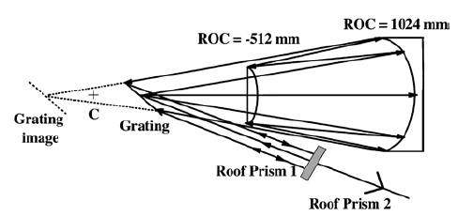
Stretcher Design
Offner Triplet – 1971 patent
The lens system of an ideal stretcher needs to be stigmatic and have zero on-axis coma
“Aberration-free stretcher design for ultrashort-pulse amplification”, G. Cheriauz, P. Rousseau, F. Salin,J.P Chambaret, B. Walker and L.F. Dimauro Opt. Lett. 21, P. 414, 1996

Slide 21
Stretcher Design
On-axis coma would cause the angle θ off of grating one, to not be at angle θ at the second grating (or second pass of the only grating)
Offner triplet has two spherical mirrors (no chromatic aberration), one concave and one convex with half the radius of curvature. The symmetry leads to only symmetric aberrations – spherical and astigmatism, but the ratio of radii of curvature of -2 cancels these aberrations. –no geometric aberrations.
“Aberration-free stretcher design for ultrashort-pulse amplification”, G. Cheriauz, P. Rousseau, F. Salin,J.P Chambaret, B. Walker and L.F. Dimauro Opt. Lett. 21, P. 414, 1996

Slide 22
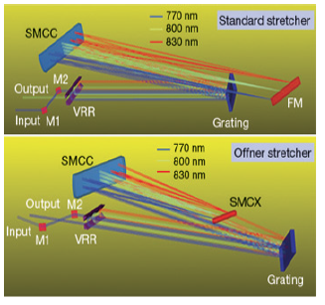
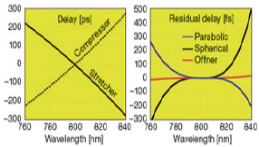
Stretcher Design
Computers at Work on Ultrafast Laser Design,
Catalin V. Filip, OPN, May 2012

Slide 23
Higher Order Dispersion
So with the Offner triplet in Littrow condition, you can match all orders of dispersion assuming a well collimated beam, (the amplifier will have a large beam, the oscillator beam should be up collimated before stretching)
You still need to compensate for the higher order terms from the rest of the optical system including the excess higher orders that come from needing unmatched GDD of the stretcher and compressor to account for the GDD of the rest of the system

Slide 24
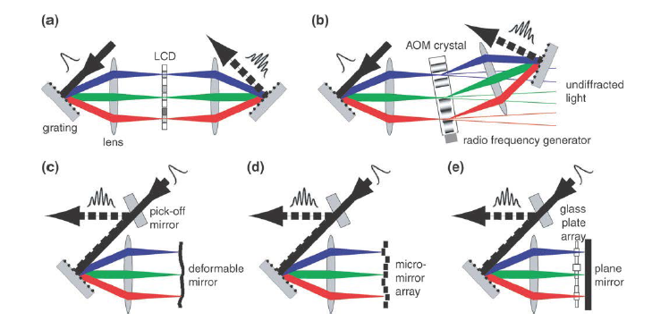
Dispersion Control : Pulse Shaping
“Femtosecond quantum control of molecular dynamics in the condensed phase” P. Nuernberger, G. Vogt, T. Brixner and G. Gerber, Phys. Chem.Chem.Phys., 9, 2470-2497, 2007

Slide 25
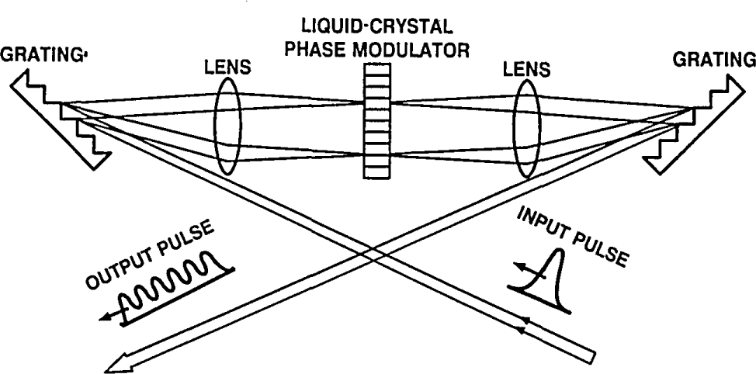
Optical Pulse Shaping
Citation A. M. Weiner, D. E. Leaird, J. S. Patel, J. R. Wullert, "Programmable femtosecond pulse shaping by use of a multielement liquid-crystal phase modulator," Opt. Lett. 15, 326-328 (1990); https://www.osapublishing.org/ol/abstract.cfm?uri=ol-15-6-326

Slide 26
Optical Pulse Shaping
Pulse shaping is based on Fourier Transforms
“We rely on the fact that if f(t) and F(ω) are a Fourier-transform pair, then the delayed signal f(t − τ) is the Fourier transform of F(ω)exp(−iωτ).”
Citation A. M. Weiner, D. E. Leaird, J. S. Patel, J. R. Wullert, "Programmable femtosecond pulse shaping by use of a multielement liquid-crystal phase modulator," Opt. Lett. 15, 326-328 (1990); https://www.osapublishing.org/ol/abstract.cfm?uri=ol-15-6-326

Slide 27
Optical Pulse Shaping
The optical spectrum is displaced along the focal plane
Transmission through a pupil or a phase array is given mathematically by multiplication so you have F(ω)φ(ω)
At the output you have the convolution of F(t)*φ(t)
If F(ω) has unwanted phase, you multiply it by the opposite phase and end up with the Fourier Transform Limited pulse
Citation A. M. Weiner, D. E. Leaird, J. S. Patel, J. R. Wullert, "Programmable femtosecond pulse shaping by use of a multielement liquid-crystal phase modulator," Opt. Lett. 15, 326-328 (1990); https://www.osapublishing.org/ol/abstract.cfm?uri=ol-15-6-326

Slide 28
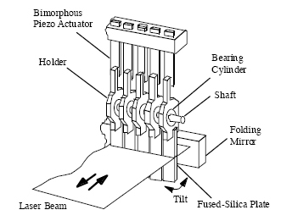
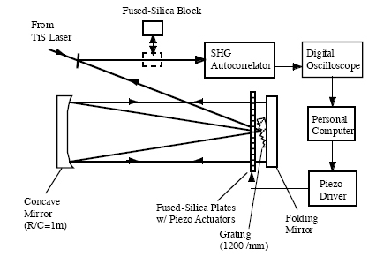
Optical Pulse Shaping
Akira Suda, Yu Oishi, Keigo Nagasaka, Pengqian Wang, Katsumi Midorikawa, "A spatial light modulator based on fused-silica plates for adaptive feedback control of intense femtosecond laser pulses," Opt. Express 9, 2-6 (2001); https://www.osapublishing.org/oe/abstract.cfm?uri=oe-9-1-2

Slide 29
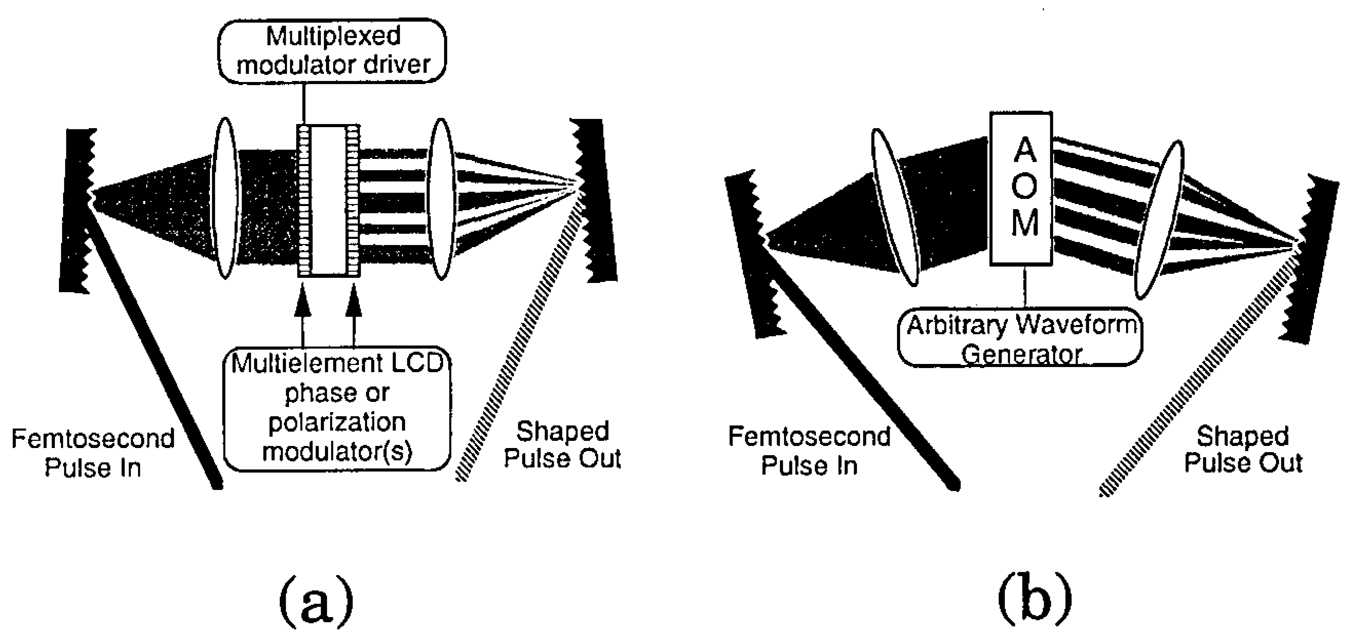
Optical Pulse Shaping
C. W. Hillegas, J. X. Tull, D. Goswami, D. Strickland, W. S. Warren, "Femtosecond laser pulse shaping by use of microsecond radio-frequency pulses," Opt. Lett. 19, 737-739 (1994); https://www.osapublishing.org/ol/abstract.cfm?uri=ol-19-10-737

Slide 30
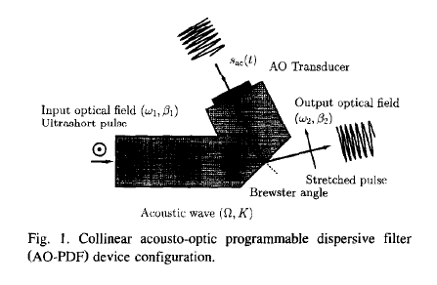
Acousto-optic pulse shaping for CPAc
“Acousto-optic programmable dispersivefilter for adaptive compensation of group delay time dispersion in laser systems”, P. Tournois, Opt. Commun. 140, 245-249, 1997

Slide 31
Acousto-optic pulse shaping for CPA
Nonlinear wave interaction between two optical waves and one acoustic wave with spectral amplitudes S.
You only get efficient scattering from ω₁ to ω₂ with perfect phase matching:

Slide 32
Acousto-optic pulse shaping for CPA
For momentum matching with perfect phase matching:
Rearranging we get:
And then:

Slide 33
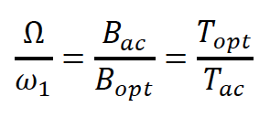
Acousto-optic pulse shaping for CPA
Because of the conservation of information between acoustic and optical signals, we have:
Where B_{ac} and B_{opt} are the acoustic and optical bandwidths respectively
and T_{ac} and T_{opt} are the acoustic and optical pulsewidths respectively

Slide 34
Acousto-optic pulse shaping for CPA
Combining these two expressions gives:
Assuming linear chirps given by B/T, then this relation gives the relation between the linear chirp of the optical wave and that of the acoustic wave that would imprint the chirp on the Fourier Transform limited pulse.

Slide 35
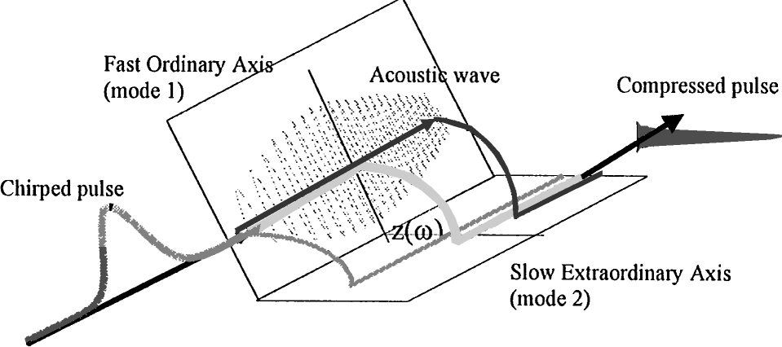
Acousto-optic pulse shaping for CPA
F. Verluise, V. Laude, Z. Cheng, Ch. Spielmann, P. Tournois, "Amplitude and phase control of ultrashort pulses by use of an acousto-optic programmable dispersive filter: pulse compression and shaping," Opt. Lett. 25, 575-577 (2000); https://www.osapublishing.org/ol/abstract.cfm?uri=ol-25-8-575

Slide 36
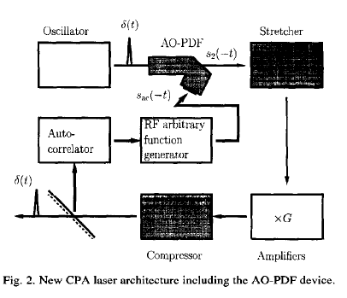
Acousto-optic pulse shaping for CPA
“Acousto-optic programmable dispersivefilter for adaptive compensation of group delay time dispersion in laser systems”, P. Tournois, Opt. Commun. 140, 245-249, 1997

Slide 37
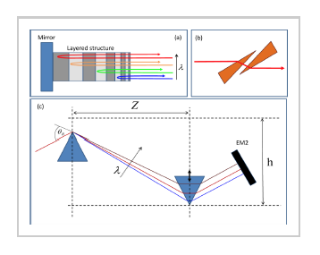
Chirp Compensation
“A Review of Cavity Design for Kerr Lens Mode-Locked Solid-State Laser”, S. Yefet and A. Pe’er, Appl. Sci. @013, 3(4), 694-724

Slide 38
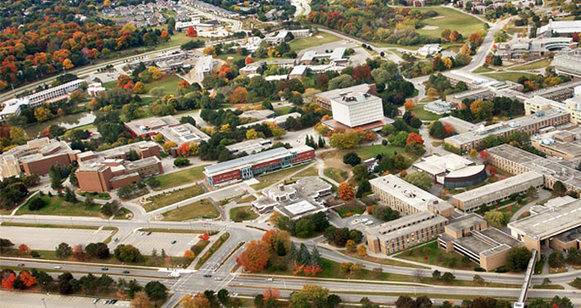
Thank You

